Slide 1
DEMO 3 Cardinals for Kids
Cardinals For Kids: Austin, Dustin, Summer, Luke, and Kevin

Slide 2
Overview
Issue at Hand: The Kids Center needs a tracking and notification system for floater patients. When an appointment becomes available, the client needs a way to notify floater patients of the free slot, and the patients then need a way to reserve the appointment slot.
Our Proposed Solution: The solution we propose is using a WordPress plugin called Simply Schedule.

Slide 3
Updates on Development Progress
Integrated Members plugin in Wordpress with SimplySchedule

Slide 4
Wordpress Members Integration
SimplySchedule allows itself to be integrated with the Members plugin on Wordpress to give specific permissions.
The best configuration for the client’s purpose is creating a therapist role that can go into the backend SimplySchedule and modify their appointment availability as they see fit.
This removes the need to have a middleman go in and make this change.
SimplySchedule Guide: https://simplyscheduleappointments.com/guides/using-members-plugin/?utm_source=plugin&utm_medium=guides&utm_campaign=support-help&utm_content=let-employees-manage-admin-page

Slide 5
SMS and Twilio
SimplySchedule uses a third-party service called Twilio to send all SMS to patients. The Twilio account must be activated and registered within the SimplySchedule plugin for SMS notifications to work.

Slide 6
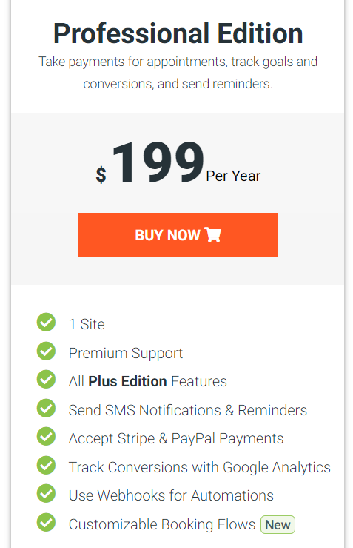
Tier of Plug-In Recommended

Slide 7
Budget Costs Per Year
SimplySchedule Cost | Twilio Phone Number Cost | Cost per Text | Number of Texts | Total Cost
$199.99 | 12 months * $1 = $12 | $.0075 | 1000 texts per week * 52 weeks = $390 | $601.99

Slide 8
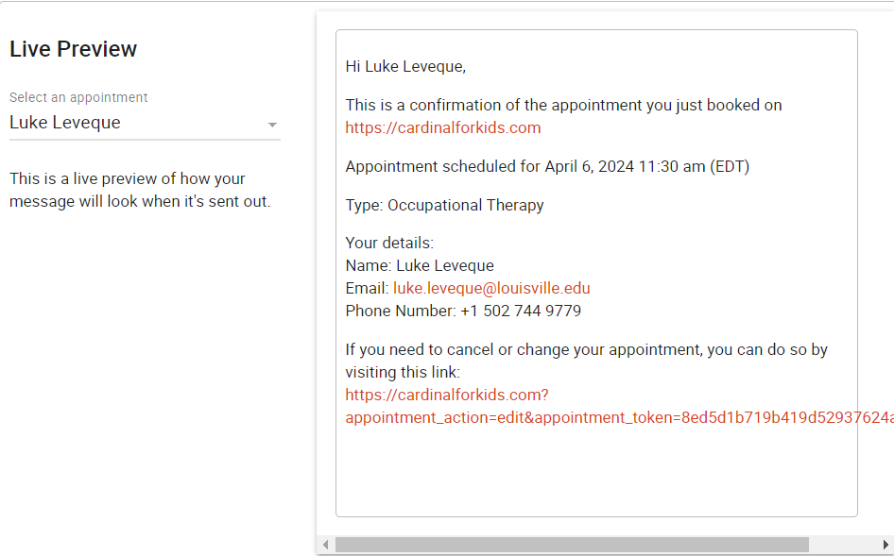
Example Screenshots
Example of the confirmation email when an appointment has been scheduled.

Slide 9
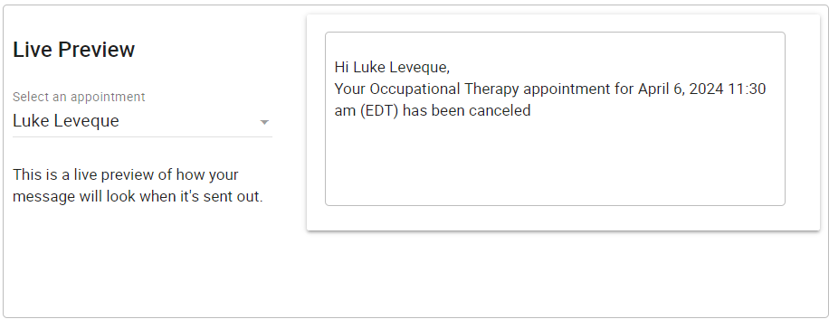
Example Screenshots
Example of the confirmation email when an appointment has been cancelled.

Slide 10
Practical Demonstration
Client Site: https://kidscenterky.org/
Demo Site: https://cardinalforkids.com/
Physical Therapy
Speech Therapy
Occupational Therapy
Page Password: NJ-PT
Page Password: ME-ST
Page Password: JH-OT
Notes:
Patients will be sent therapist/service specific URLS (shown URLS will not be representative to actual product).
- Best practice for client would be to make those pages required their login credentials
Users securely access page -> Select Appointment Date -> Select Time -> Enter Information

Slide 11






Questions?

Slide 12
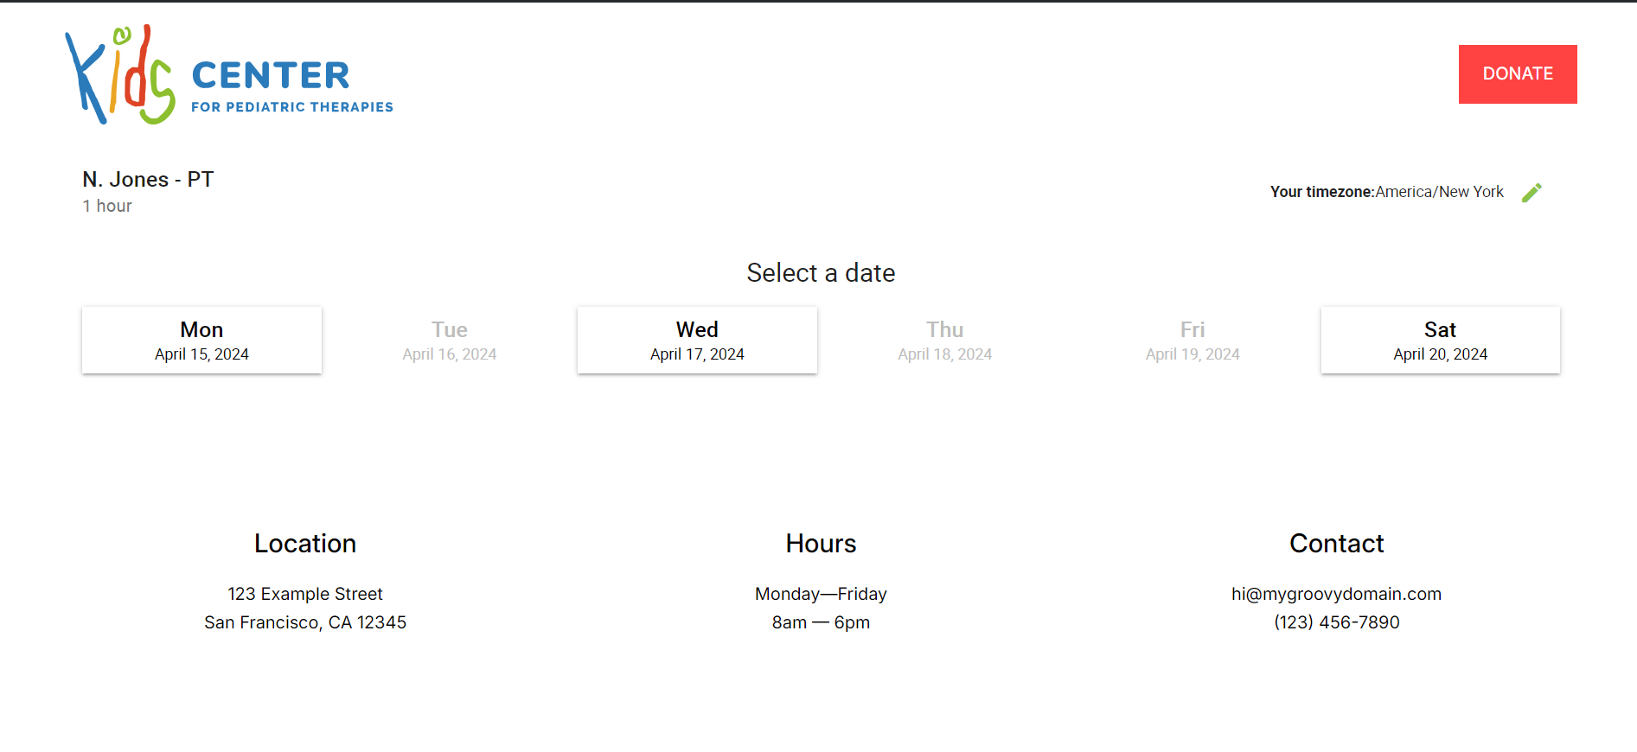
User Scheduling

Slide 13
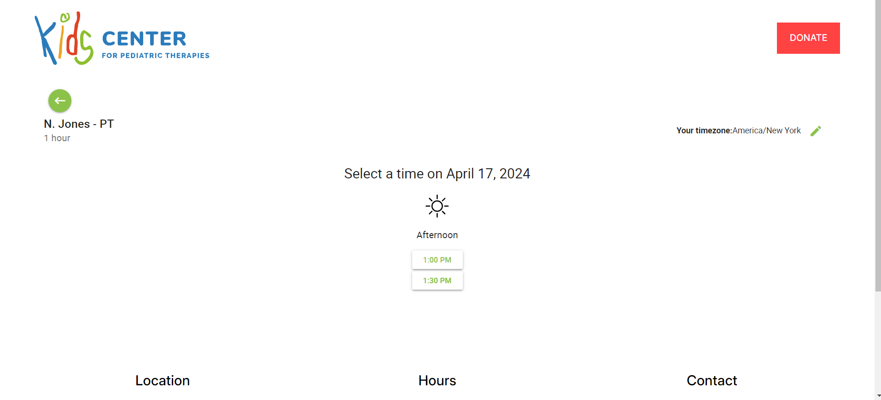
User Scheduling

Slide 14
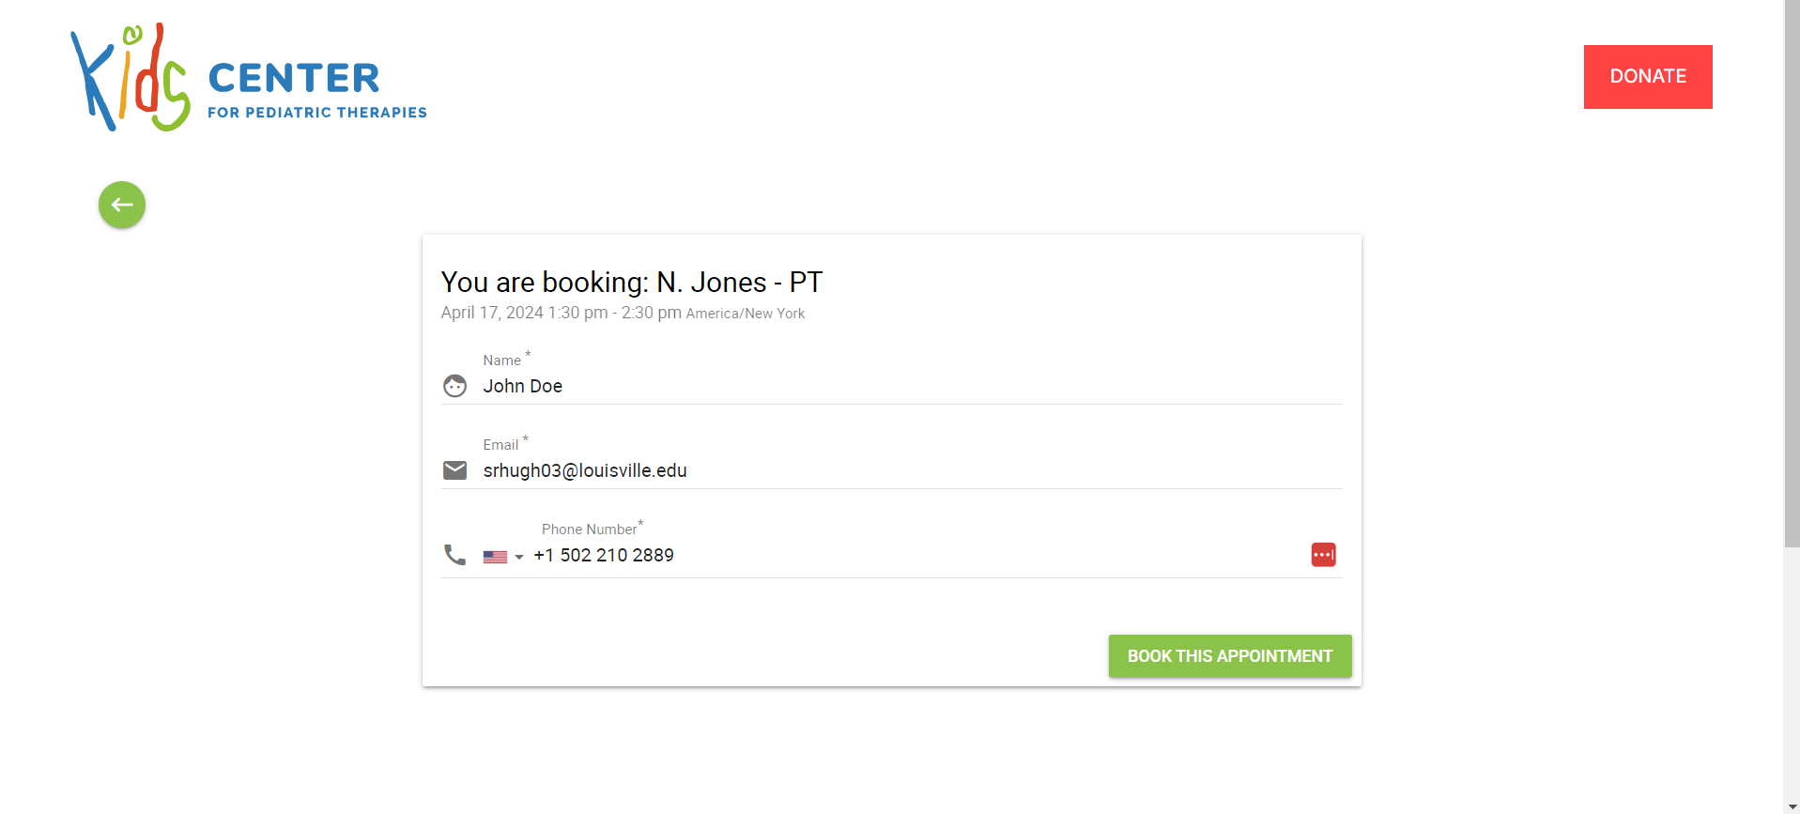
User Scheduling

Slide 15
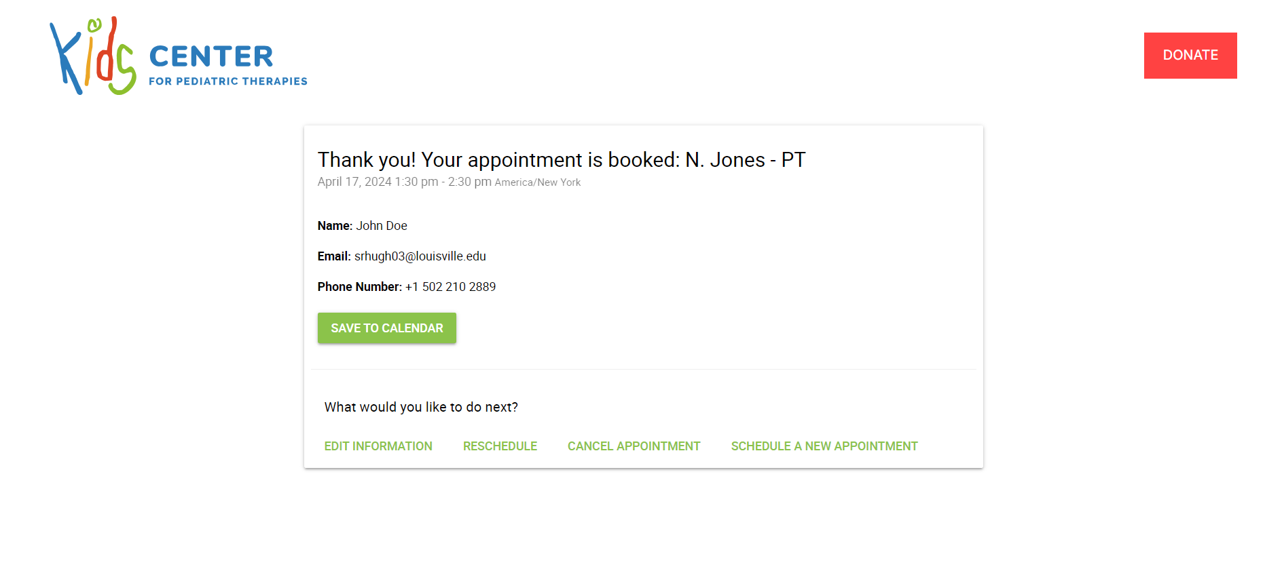
User Scheduling

Slide 16
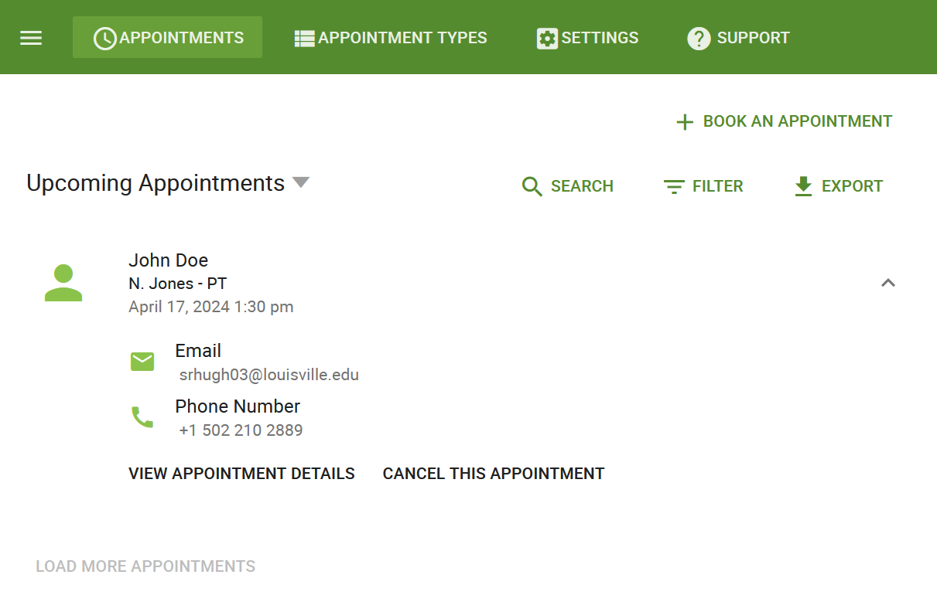
Appointment Type Management

Slide 17
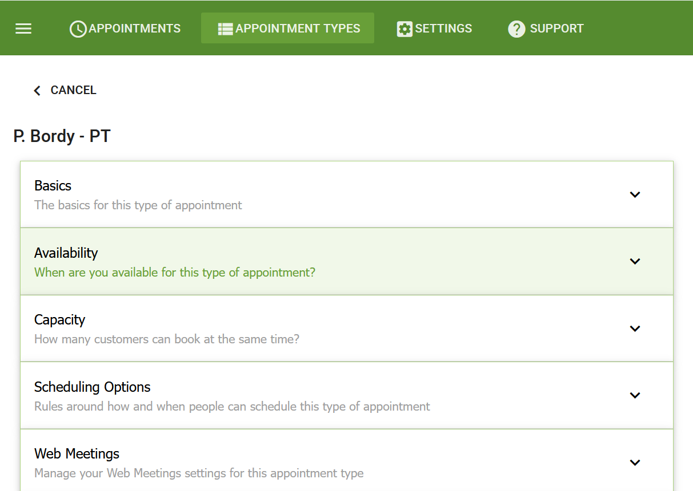
Appointment Type Management

Slide 18
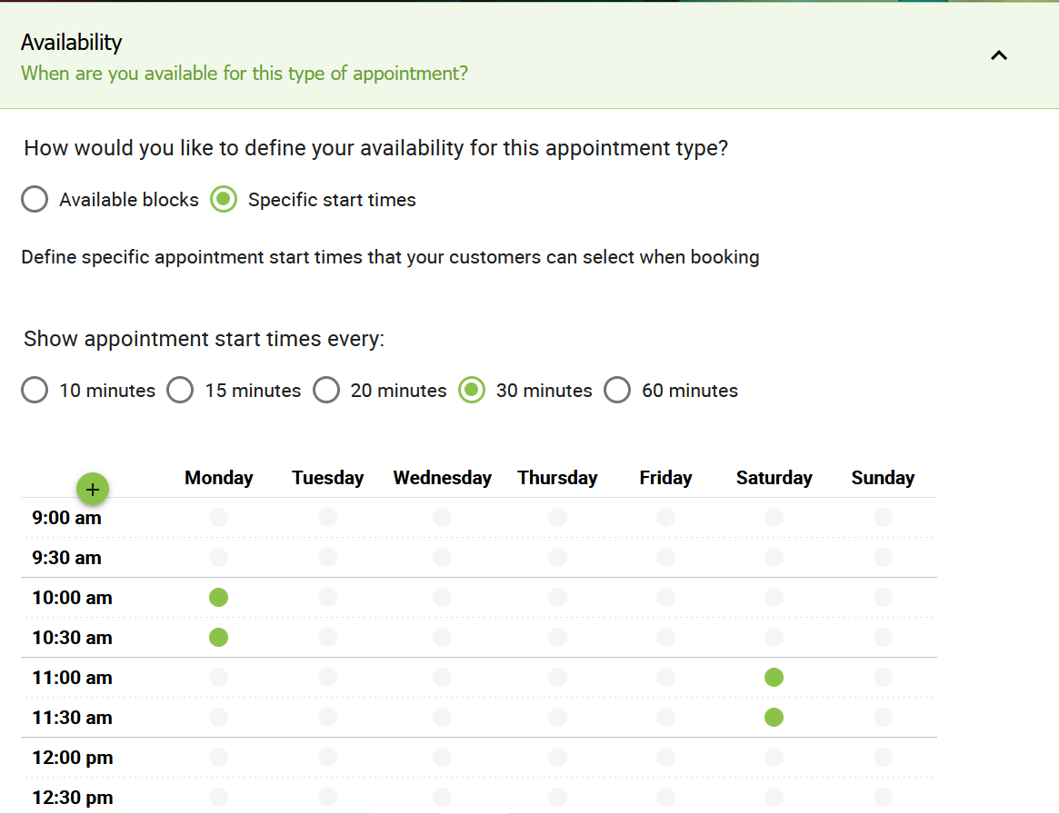
Appointment Type Management

Slide 19
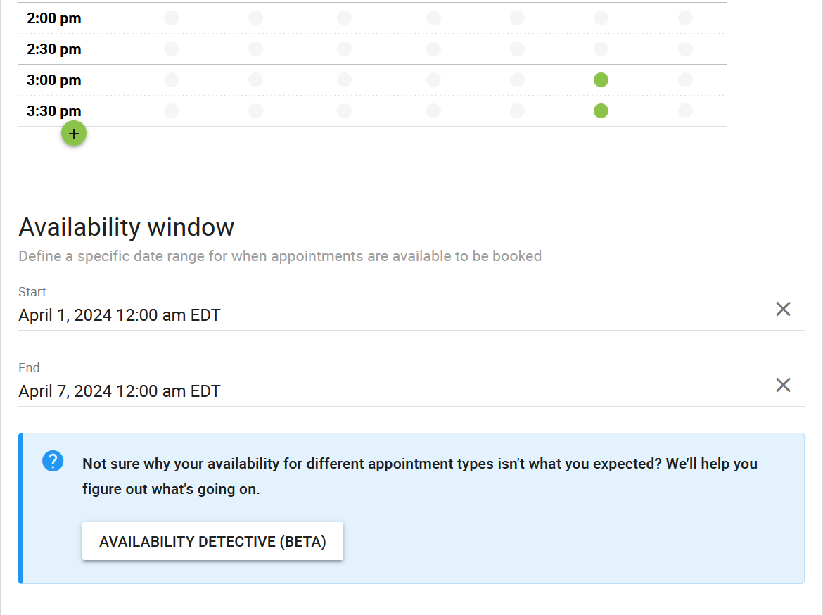
Appointment Type Management

